Slide 1
The stock of Irish businesses: Implications for Irish development policy
Dr. Bernadette Power,
School of Economics, Cork University Business School.
Rethinking Irish Economic Development
3rd November 2017

Slide 2
Agenda
Business Demography Data
Key Trends
Policy Implications I
Case Evidence
Policy Implications II & III

Slide 3
Ireland’s Business Demography Data 2006-2014
Business Demography
Data
Enterprise Births
Active
Enterprises
Enterprise
Deaths
Business Demography Statistics, Central Statistics Office

Slide 4
Enterprise Births & Deaths Relative to Active Firms

Slide 5
% Change in Stock of Active Enterprises by Region relative to 2008

Slide 6
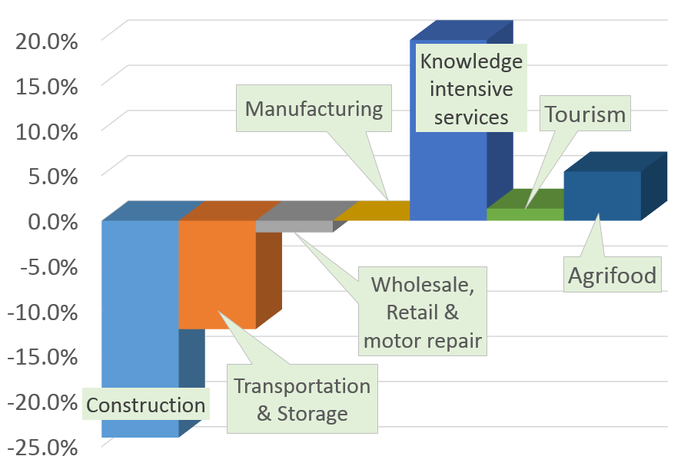
The Stock of Businesses % Change (2008-2014)

Slide 7
Hi Tech Manufacturing & Knowledge Intensive Firms 2014
Low Tech Manuf - 1.8%
Medium Low Tech Manuf - 1.6%
High Medium Tech Manuf - 0.4%
High Tech Manuf - 0.1%
Knowledge intensive services 2008 – 90,072 (24.5)
2014 – 108,481 (28.7 )

Slide 8
Regional Dist. of Manufacturing & KIS Firms 2014
 | Border | Dublin | Mid East | Mid-land | Mid West | South East | South West | West
Other | 44.0 | 12.8 | 29.4 | 44.1 | 41.1 | 39.7 | 37.7 | 45.4
Low Knowledge IS | 33.2 | 40.6 | 36.7 | 31.8 | 31.8 | 33.6 | 33.1 | 30.3
Knowledge IS | 18.7 | 44.9 | 29.6 | 19.4 | 21.9 | 22.2 | 25.8 | 20.9
Low Tech | 1.9 | 1.6 | 2.0 | 1.9 | 1.6 | 2.1 | 1.7 | 1.6
Medium Low Tech | 1.8 | 0.9 | 1.8 | 2.1 | 1.9 | 2.2 | 1.8 | 1.5
High Medium Tech | 0.3 | 0.3 | 0.4 | 0.3 | 0.4 | 0.4 | 0.4 | 0.3
High Tech | 0.1 | 0.2 | 0.2 | 0.1 | 0.1 | 0.1 | 0.2 | 0.1

Slide 9
Regional Dist. of Manufacturing & KIS Firms 2014
 | Border | Dublin | Mid East | Mid-land | Mid West | South East | South West | West
Other | 44.0 | 12.8 | 29.4 | 44.1 | 41.1 | 39.7 | 37.7 | 45.4
Low Knowledge IS | 33.2 | 40.6 | 36.7 | 31.8 | 31.8 | 33.6 | 33.1 | 30.3
Knowledge IS | 18.7 | 44.9 | 29.6 | 19.4 | 21.9 | 22.2 | 25.8 | 20.9
Low Tech | 1.9 | 1.6 | 2.0 | 1.9 | 1.6 | 2.1 | 1.7 | 1.6
Medium Low Tech | 1.8 | 0.9 | 1.8 | 2.1 | 1.9 | 2.2 | 1.8 | 1.5
High Medium Tech | 0.3 | 0.3 | 0.4 | 0.3 | 0.4 | 0.4 | 0.4 | 0.3
High Tech | 0.1 | 0.2 | 0.2 | 0.1 | 0.1 | 0.1 | 0.2 | 0.1

Slide 10
Regional Dist. of Manufacturing & KIS Firms 2014
 | Border | Dublin | Mid East | Mid-land | Mid West | South East | South West | West
Other | 44.0 | 12.8 | 29.4 | 44.1 | 41.1 | 39.7 | 37.7 | 45.4
Low Knowledge IS | 33.2 | 40.6 | 36.7 | 31.8 | 31.8 | 33.6 | 33.1 | 30.3
Knowledge IS | 18.7 | 44.9 | 29.6 | 19.4 | 21.9 | 22.2 | 25.8 | 20.9
Low Tech | 1.9 | 1.6 | 2.0 | 1.9 | 1.6 | 2.1 | 1.7 | 1.6
Medium Low Tech | 1.8 | 0.9 | 1.8 | 2.1 | 1.9 | 2.2 | 1.8 | 1.5
High Medium Tech | 0.3 | 0.3 | 0.4 | 0.3 | 0.4 | 0.4 | 0.4 | 0.3
High Tech | 0.1 | 0.2 | 0.2 | 0.1 | 0.1 | 0.1 | 0.2 | 0.1

Slide 11
Implications for Enterprise Policy
Leverage core strengths
Address regional imbalances
Manufacturing
Regionally dispersed – Regional job opportunities.
Transition to more high end manufacturing sectors.

Slide 12
Size Distribution
Growth is only occurring in approximately 10% or less of enterprises between 2008 and 2014.

Slide 13
Case Evidence: Firm Survival
Attributes which foster survival & offer greater resistance to economic shocks
Larger businesses
Older businesses
Firms operating in concentrated markets.
Firms operating in knowledge intensive services.
Firms located in rural regions.
Failure risks of firms fall considerably if they have scale – At least 5+ employees

Slide 14
Implications for Enterprise Policy
Only 10% or less firms growing in size
Focus on scaling businesses

Slide 15
Case Evidence: Entrepreneurship, Firm Survival and Agglomeration Economies
Entrepreneurship
Greater population density raises regional births rates
Firm Exits
Specialisation lowers regional deaths rates.

Slide 16
Implications for Policy
Developing other key urban centres
Local knowledge is key - bottom up approach to development.
Leverage strengths of the region

Slide 17
Thank you for Listening Any Questions?
Contact Details:
Dr. Bernadette Power:
b.power@ucc.ie
?

